Slide 1
DNA Sequencing:
a (nano)technology perspective
Dr Paolo Actis
p.actis@leeds.ac.uk

Slide 2
DNA
Molecule that carries the information for the growth, development, functioning and reproduction of all known living organisms (and viruses)

Slide 3
DNA
Molecule that carries the information for the growth, development, functioning and reproduction of all known living organisms
Composed of 4 units called nucleotides (or bases): A,C,G,T
Human Genome contains 3 billion bases
(SARS-COV-2 about 30,000)

Slide 4
DNA (2)
The structure of DNA is a double helix
A binds T and C binds G

Slide 5
DNA
Let’s take this single stranded DNA sequence as an example:
G A A C T T A A T T A A

Slide 6
DNA
The double stranded version will be immediately determined as:
G A A C T T A A T T A A C T T G A A T T A A T T

Slide 7
Polymerase Chain Reaction (PCR)
When you warm it up (around 95 C) , the two strands separate
GAACTTAATTAA
CTTGAATTAATT

Slide 8
Polymerase Chain Reaction (PCR)
Add a short, specific bit of complementary DNA at either end (a primer)
GAACTTAATTAA CTT
GAA CTTGAATTAATT
Primers

Slide 9
Polymerase Chain Reaction (PCR)
Cool it down again, and the enzyme polymerase (the P in PCR) fills in the rest, so you end up with two identical, “photocopied” versions of the original bit of DNA.
GAACTTAATTAA CTTGAATTAATT GAACTTAATTAA CTTGAATTAATT

Slide 10
Polymerase Chain Reaction (PCR)
Repeat the cycle a few times, and you have billions of copies, and this specific bit of DNA is now easy to detect.

Slide 11
Polymerase Chain Reaction (PCR)
PCR COVID testing relies on 3 set of primers targeting 3 different regions of the SARS-COV-2 genome
To read more about PCR covid testing
https://www.genome.gov/about-genomics/fact-sheets/Understanding-COVID-19-PCR-Testing

Slide 12
Polymerase Chain Reaction (PCR)
You will learn more about PCR in the Labster lab check it out on the module Minerva page under UNIT 1.1)

Slide 13
Why do we need to sequence DNA?

Slide 14
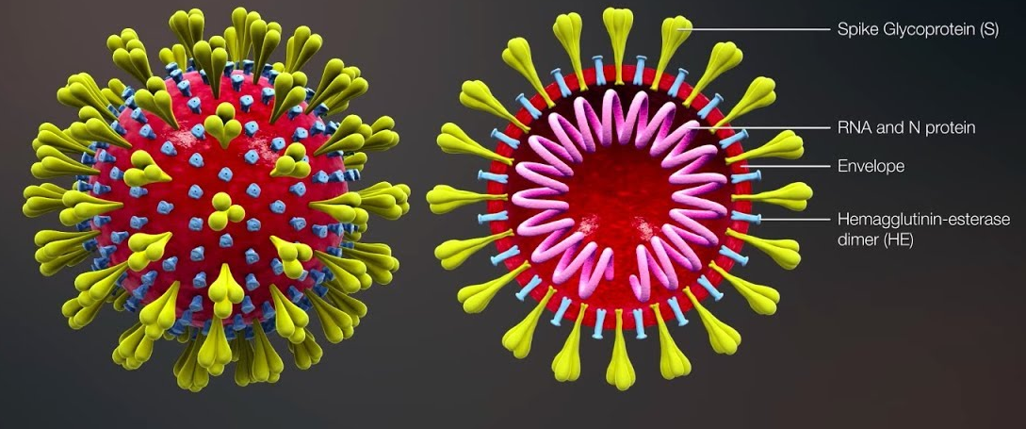
To discover new virus like SARS-COV-2
Source: www.ovg.ox.ac.uk/news/covid-19-vaccine-development

Slide 15
To help design vaccines against SARS-COV-2
Source: www.ovg.ox.ac.uk/news/covid-19-vaccine-development

Slide 16
To understand where SARS-COV-2 came from
It is 30,000 bases long (human genome is 3 billion)
Source: SARS-CoV-2 (COVID-19) by the numbers, Bar-On et al, eLife

Slide 17
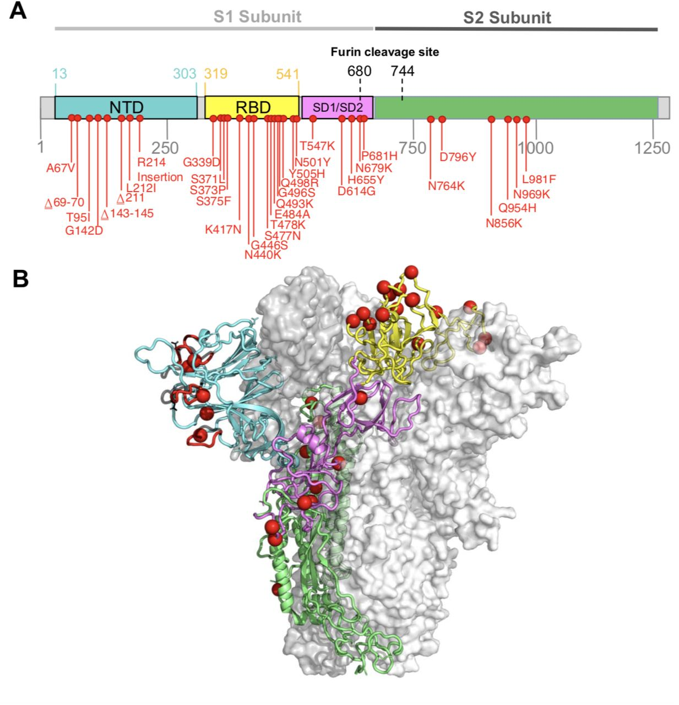
To study virus evolution
Omicron RNA genome with mutations in red (compared to “original” virus)
Mutation in the genome lead to changes in the composition of the spike protein which lead to higher infectivity
https://www.medrxiv.org/content/10.1101/2021.12.19.21268028v1.full

Slide 18
Why DNA Sequencing ?
Comparative Genomics
Sequencing of many animal species
Structure and function of the human genome
Genome evolution
Human Genetic Variation
Genomic contribution to disease
Agricultural important species
Microbial Communities
Medical
Environmental
Food
Bioterrorism

Slide 19
What questions do you have?

Slide 20
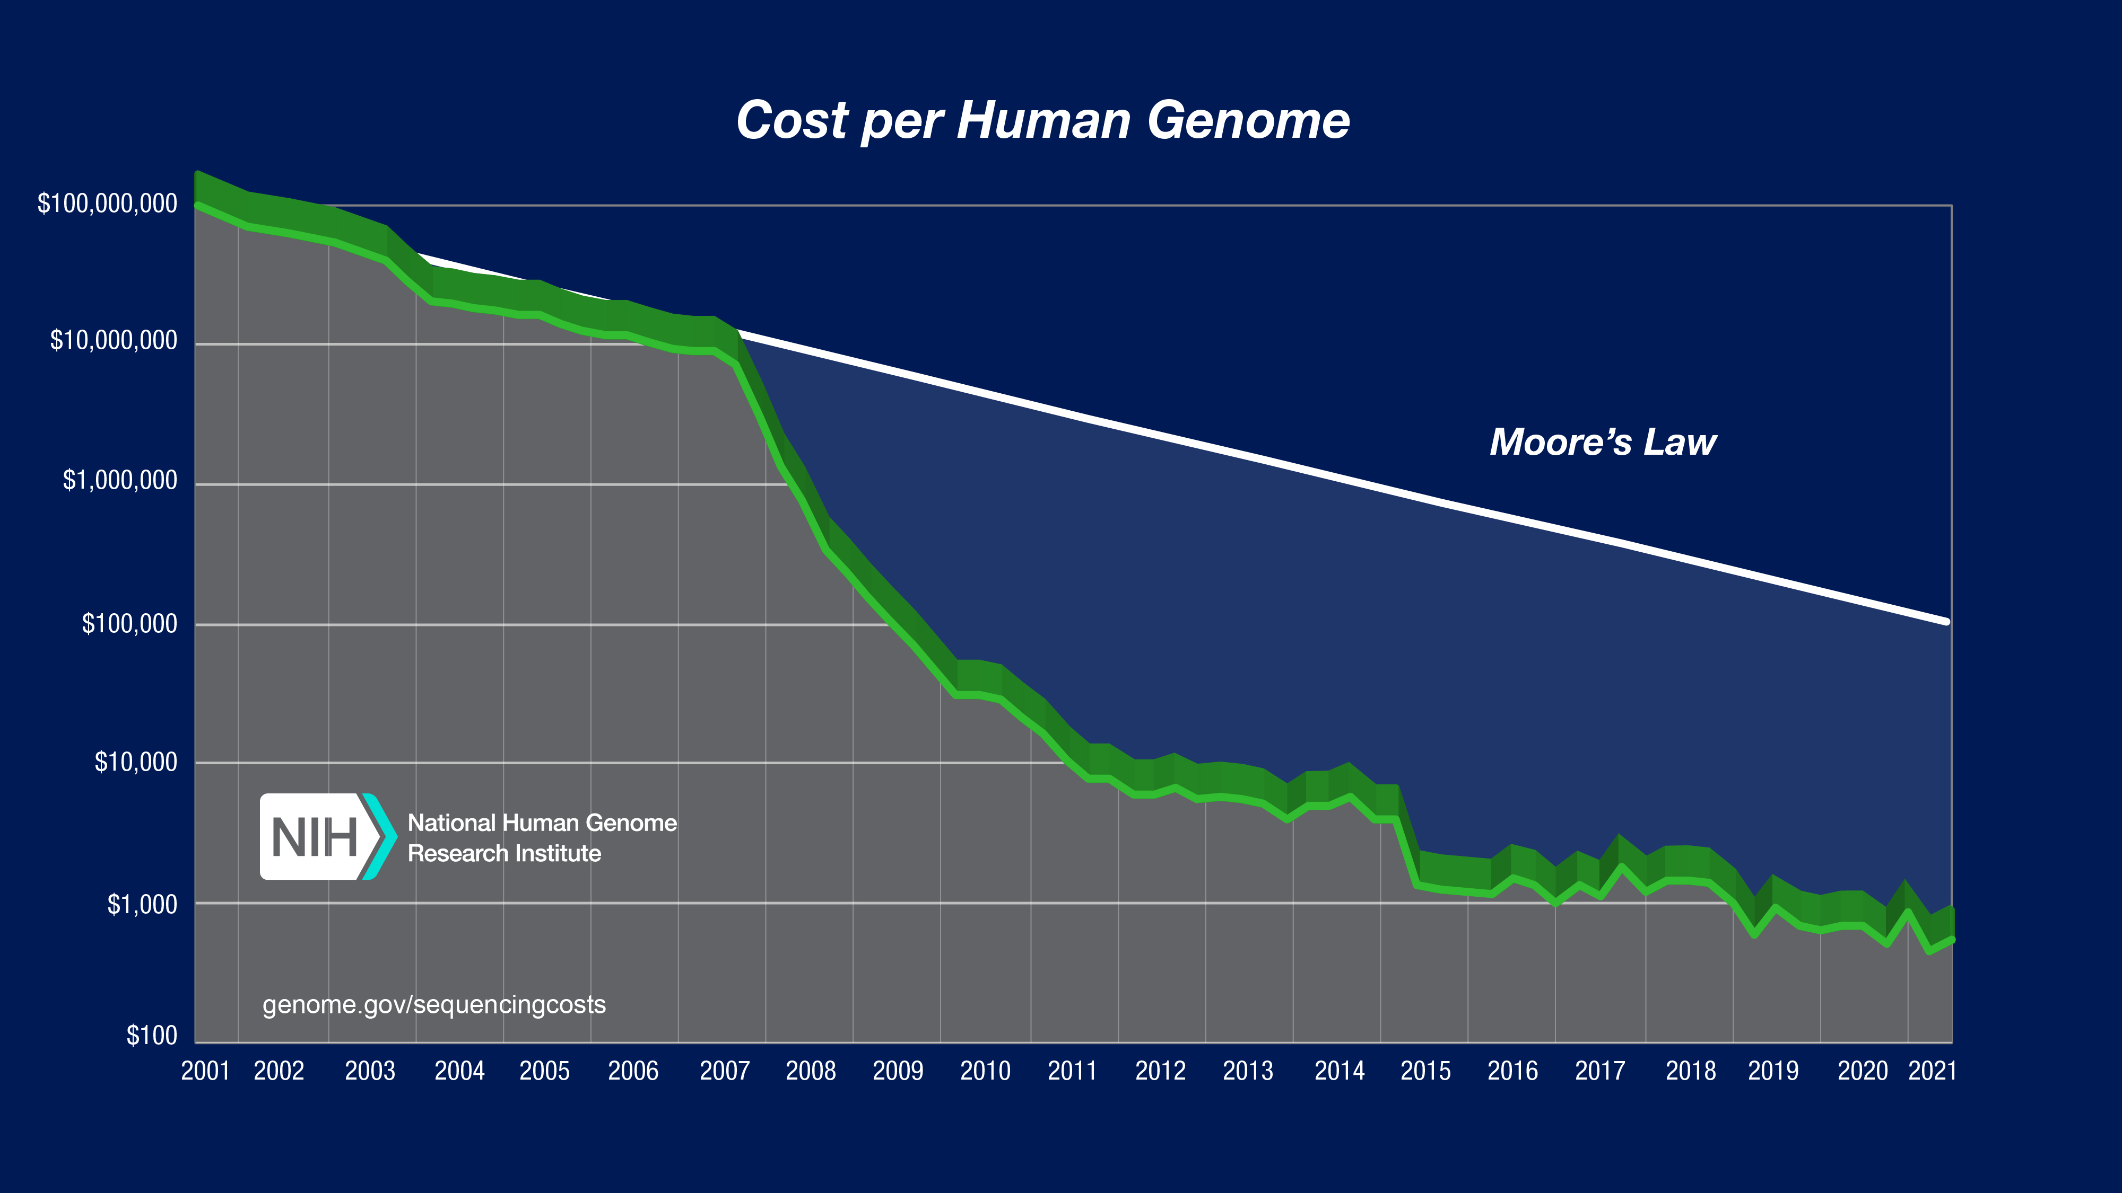

Slide 22
Year 2000

Slide 24
Next-Generation Sequencing
Massively Parallel
Higher throughput
Lower cost
Faster
More accurate
Although
Shorter read lengths

Slide 25
Facebook profile pic
Paolo, 2008

Slide 26
Sequencing by Synthesis
DNA is sheared into 200bp pieces
The sheared DNA is attached to the surface of a flow cell
The attached DNA is amplified via PCR
Sequencing by synthesis using fluorescently labelled nucleotides

Slide 27
Sequencing by Synthesis
You will learn more about next-generation sequencing in the Labster lab (check it out on the module Minerva page)

Slide 28
Questions

Slide 29
DNA sequencing enabled by electronics
Why?

Slide 30
DNA sequencing enabled by electronics
Because of industrial capabilities
Electronics is highly parallel
Low-cost
Small footprint
Low power consumption
No need for optics/lasers

Slide 31
MOSFET

Slide 32
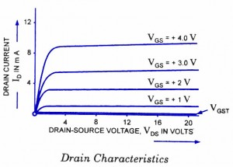
MOSFET
Source: circuitstoday.com/emosfet

Slide 33
MOSFET (Dry) vs DNA sequencing (Wet)

Slide 34
MOSFET vs ISFET

Slide 35
ISFET (ion-sensitive FET)
SiO₂ layer is sensitive to pH (concentration of H⁺ in solution)
The pH of the solution affects the source-drain current

Slide 36
ISFET (Wet) vs DNA sequencing (Wet)
We solved one problem
and
we know that ISFET is a great pH sensor
but
how do we sequence DNA???

Slide 37
ISFET (ion-sensitive FET) sequencing
When DNA polymerase (remember the P in PCR) fills in a new nucleotide a H⁺ ions is released !!!!
You will learn more about ISFET sequencing in Ion Torrent video ( on Minerva under Unit 1.1)

Slide 38
ISFET Reading
An integrated semiconductor device enabling non-optical genome sequencing, Nature, 2011
Piet Bergveld - 40 years of ISFET technology: From neuronal sensing to DNA sequencing, Electronics Letter, 2011

Slide 39
Third Generation Sequencing

Slide 40
Third Generation Sequencing
Nanopore Sequencing (Oxford Nanopores)
SMRT sequencing (Pacific Biosciences) (we will not discuss this technology)

Slide 41
Third Generation Sequencing
Longer reads
Portable (Oxford Nanopore)
Speed (Oxford Nanopore, see reading “Ultrarapid Nanopore Genome Sequencing in a Critical Care Setting” in UNIT 1 DNA sequencing readings)

Slide 42
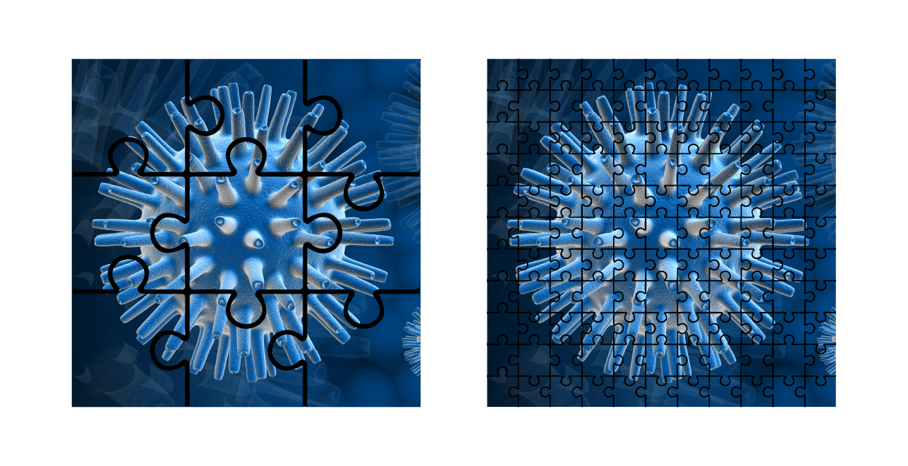
Third Generation Sequencing
Source: https://nanoporetech.com/how-it-works

Slide 44
Nanopore Sequencing
Wikipedia

Slide 45
Challenges
Width of single stranded DNA is 1.5 nm.
How do you make nanopores this small?
DNA travels through the nanopore really fast (less than 10 𝛍s) and causes a modulation in the current of few tens of pA
How do you read single bases?

Slide 46
Nanopores
Nature Biotech, 2016

Slide 47
How to slow down DNA
Nanopore
Motor Protein
(like DNA polymerase)
A motor protein sits on top of the nanopore and ratchets DNA down the nanopore with a controlled speed
Nature Biotech, 2012

Slide 48
You will learn more about nanopore sequencing in the Introduction to Nanopore Sequencing
( on Minerva under Unit1/ Videos DNA Sequencing)

Slide 49
Nanopore Reading
Automated forward and reverse ratcheting of DNA in a nanopore at 5-Å precision, Nature Biotech, 2012
Three decades of nanopore sequencing, Nature Biotech, 2016

Slide 50
Question

